Slide 1
Document Classification Survey
Kai Niu
20/12/2020

Slide 2

Outline
Background Introduction
Method illustration
Conclusion

Slide 3
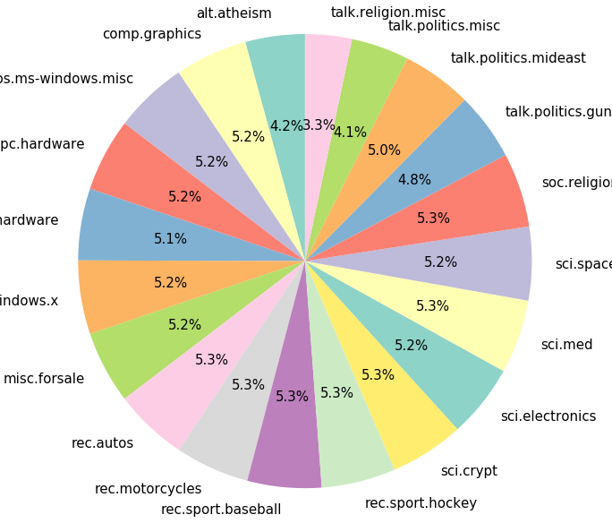

Background
Document classification is the act of labeling documents into categories according to their content. It is one of the most important task in NLP area.
Dataset: The 20 newsgroups dataset comprises around 18000 newsgroups posts on 20 topics split in two subsets
Evaluation criteria: Precision.

Slide 4
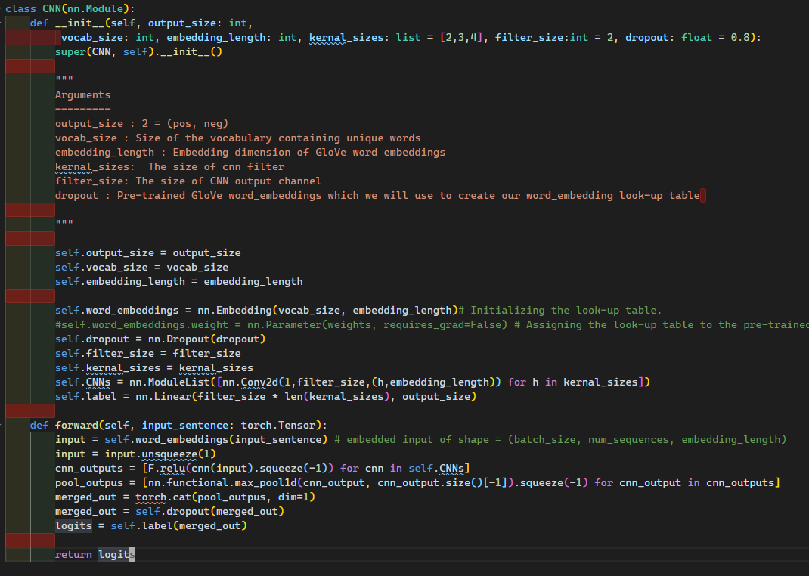
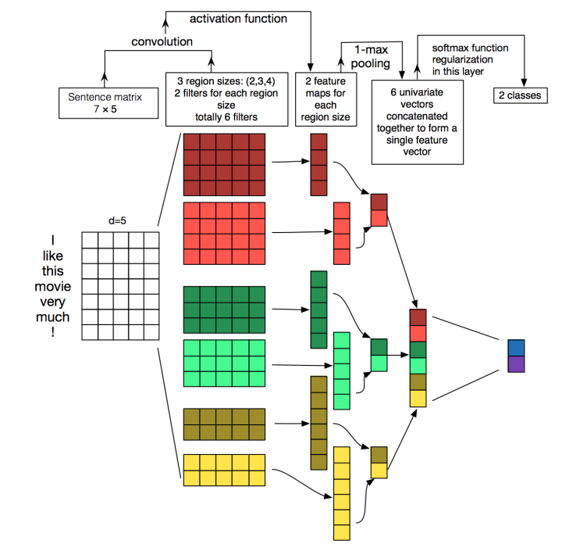
TextCNN
Filter_size | 64 | 128 | 256
Precision | 0.7936 | 0.766 | 0.796
Dropout_rate | 0.4 | 0.5
Precision | 0.772 | 0.7936

Slide 5
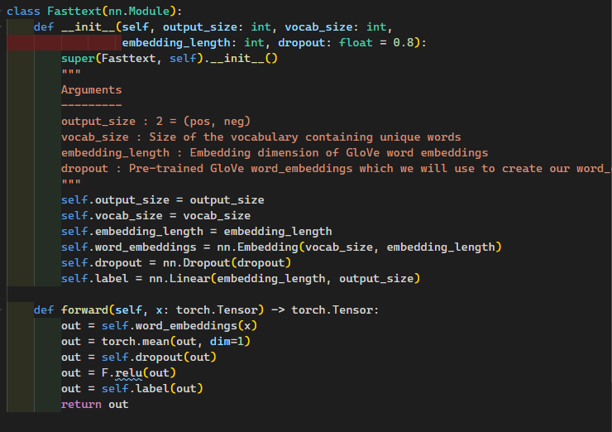
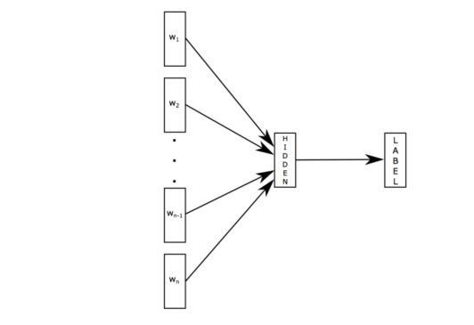
Fasttext
Dropout_rate | 0.3 | 0.4 | 0.5
Precision | 0.806 | 0.8105 | 0.8126

Slide 6
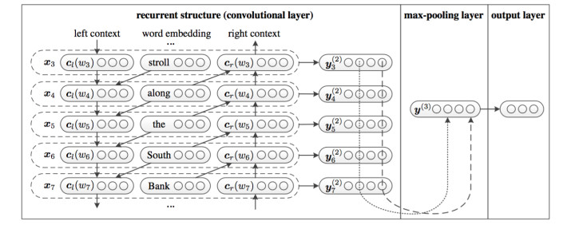
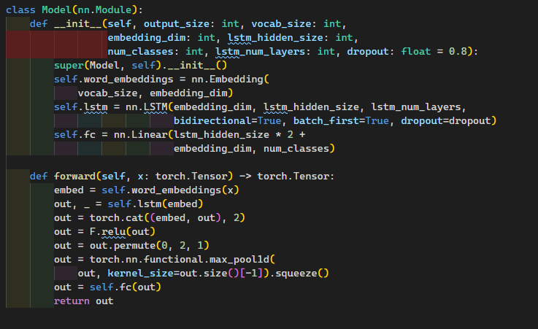
Recurrent Convolutional Neural Networks for Text Classification
performance | lstm_hidden_size | lstm_num_layers
0.802 | 256 | 1
0.766 | 256 | 2
0.7873 | 512 | 1
0.7831 | 512 | 2

Slide 7
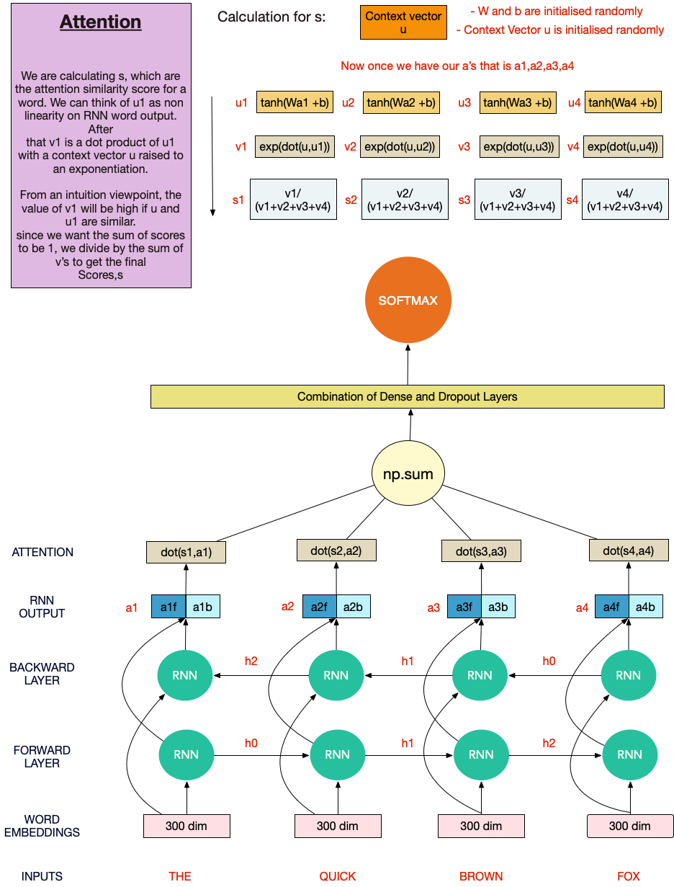
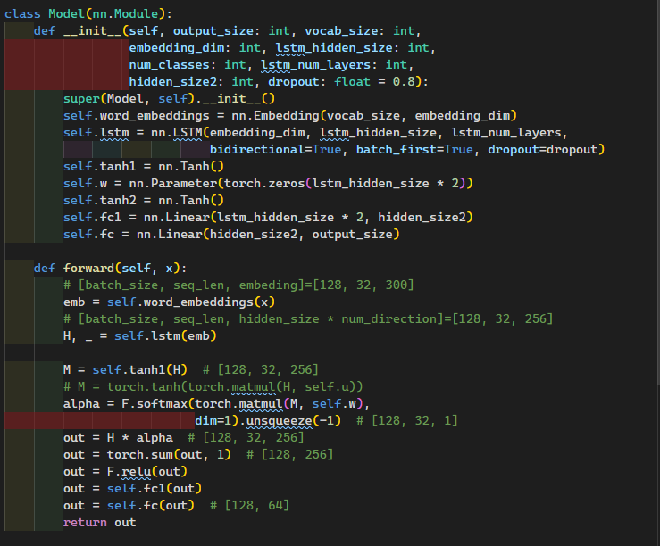
Attention-Based Bidirectional Long Short-Term Memory Networks for Relation Classification

Slide 8
Performance | Lstm_hidden_size | Lstm_num_layers | Attention_dim
0.813 | 512 | 1 | 128
0.68 | 512 | 2 | 128
0.806 | 256 | 1 | 64
0.768 | 256 | 2 | 64
0.817 | 256 | 1 | 128
0.747 | 256 | 2 | 128
Performance | Lstm_hidden_size | Lstm_num_layers | Attention_dim
0.787 | 512 | 1 | 64
0.813 | 512 | 1 | 128
0.806 | 256 | 1 | 64
0.817 | 256 | 1 | 128
0.768 | 256 | 2 | 64
0.747 | 256 | 2 | 128
Performance | Lstm_hidden_size | Lstm_num_layers | Attention_dim
0.813 | 512 | 1 | 128
0.817 | 256 | 1 | 128
0.68 | 512 | 2 | 128
0.747 | 256 | 2 | 128
0.787 | 512 | 1 | 64
0.806 | 256 | 1 | 64

Slide 9
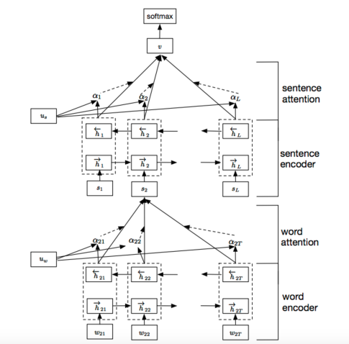
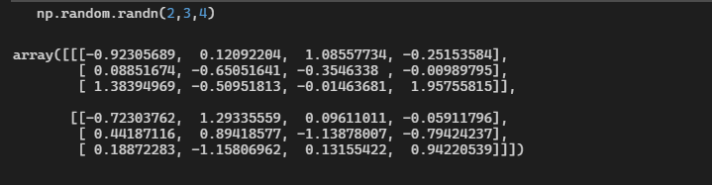
The input is a three dimension Tensor. [Batch * max_sentence_nums * max_word_nums]
Hierarchical-Attention-Network
Sentence
Document

Slide 10
Performance | word_gru_hidden_dim | sent_gru_hidden_dim | dropout_rate | word_gru_num_layers | sent_gru_num_layers | word_att_dim | sent_att_dim
0.812632 | 256 | 256 | 0.5 | 1 | 1 | 200 | 200
0.8084 | 512 | 512 | 0.5 | 1 | 1 | 200 | 200
0.8042 | 512 | 256 | 0.5 | 1 | 1 | 200 | 200
0.8147 | 256 | 512 | 0.5 | 1 | 1 | 200 | 200
0.806316 | 256 | 256 | 0.2 | 1 | 1 | 200 | 200
0.797895 | 512 | 512 | 0.2 | 1 | 1 | 200 | 200
0.814737 | 512 | 256 | 0.2 | 1 | 1 | 200 | 200
0.795789 | 256 | 512 | 0.2 | 1 | 1 | 200 | 200
Performance | word_gru_hidden_dim | sent_gru_hidden_dim | dropout_rate | word_gru_num_layers | sent_gru_num_layers | word_att_dim | sent_att_dim
0.812632 | 256 | 256 | 0.5 | 1 | 1 | 200 | 200
0.814737 | 256 | 256 | 0.5 | 1 | 2 | 200 | 200
0.8 | 256 | 256 | 0.5 | 2 | 1 | 200 | 200
0.810526 | 256 | 256 | 0.5 | 2 | 2 | 200 | 200
0.8147 | 256 | 512 | 0.5 | 1 | 1 | 200 | 200
0.806316 | 256 | 512 | 0.5 | 1 | 2 | 200 | 200
0.825263 | 256 | 512 | 0.5 | 2 | 1 | 200 | 200
0.810526 | 256 | 512 | 0.5 | 2 | 2 | 200 | 200
0.8042 | 512 | 256 | 0.5 | 1 | 1 | 200 | 200
0.8042 | 512 | 256 | 0.5 | 1 | 2 | 200 | 200
0.8 | 512 | 256 | 0.5 | 2 | 1 | 200 | 200
0.8063 | 512 | 256 | 0.5 | 2 | 2 | 200 | 200
0.8084 | 512 | 512 | 0.5 | 1 | 1 | 200 | 200
0.8189 | 512 | 512 | 0.5 | 1 | 2 | 200 | 200
0.802 | 512 | 512 | 0.5 | 2 | 1 | 200 | 200
0.812632 | 512 | 512 | 0.5 | 2 | 2 | 200 | 200

Slide 11
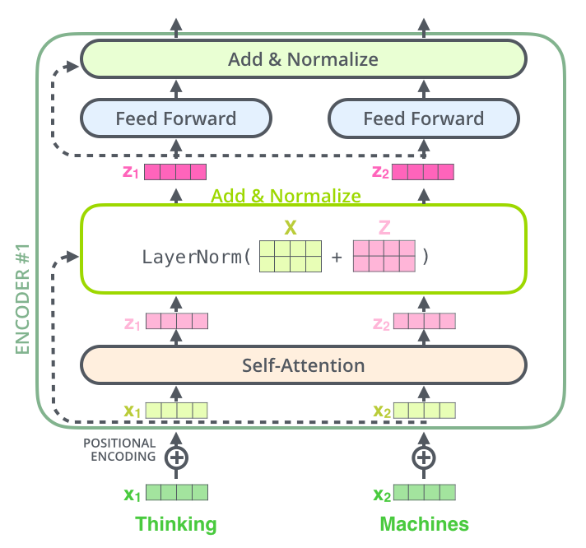
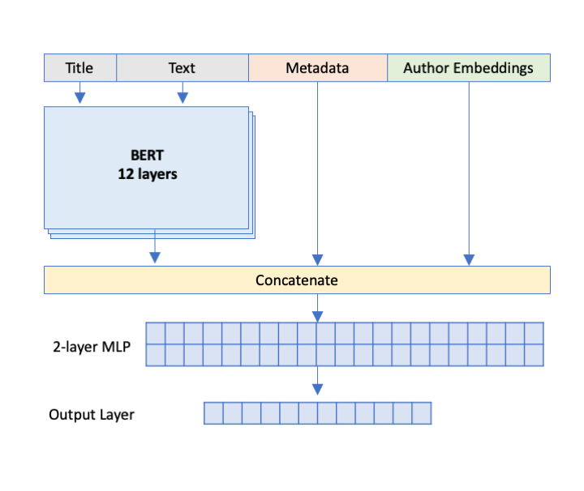
BERT Document Classification
Input
[CLS]
Input

Slide 12
Performance Comparison
Model | RCNN | LSTM_Att | HAN | Fasttext | CNN | Bert
Precision | 0.8201 | 0.8168 | 0.8253 | 0.8126 | 0.7958 | 0.937

Slide 13

Citation
Fasttext: https://arxiv.org/pdf/1607.01759v2.pdf
TextCNN: https://arxiv.org/abs/1408.5882
HAN: https://www.cs.cmu.edu/~./hovy/papers/16HLT-hierarchical-attention-networks.pdf
RCNN: https://www.aaai.org/ocs/index.php/AAAI/AAAI15/paper/download/9745/9552
Bert: https://arxiv.org/pdf/1905.05583.pdf

Slide 14
Thank You

